Slide 1


Loli Adventure
0856610 郭聖弘 0856727洪冠群
Game Logo:
Course Project for 3D Game Programming
Instructor: Sai-Keung Wong
NCTU,
2019/01/13

Slide 2
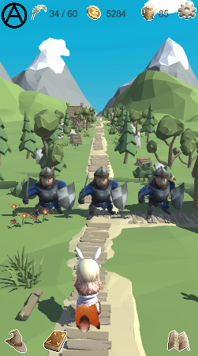
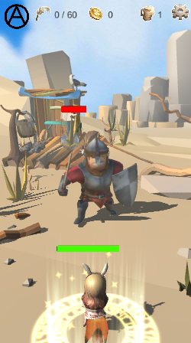
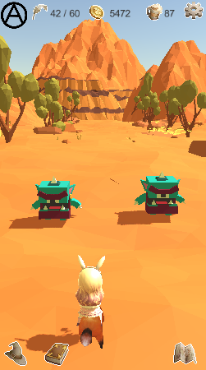
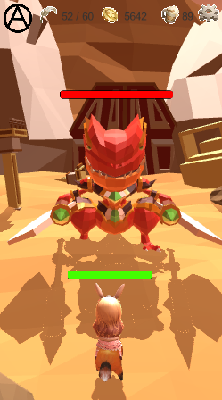
Representative images
Say something about them

Slide 3
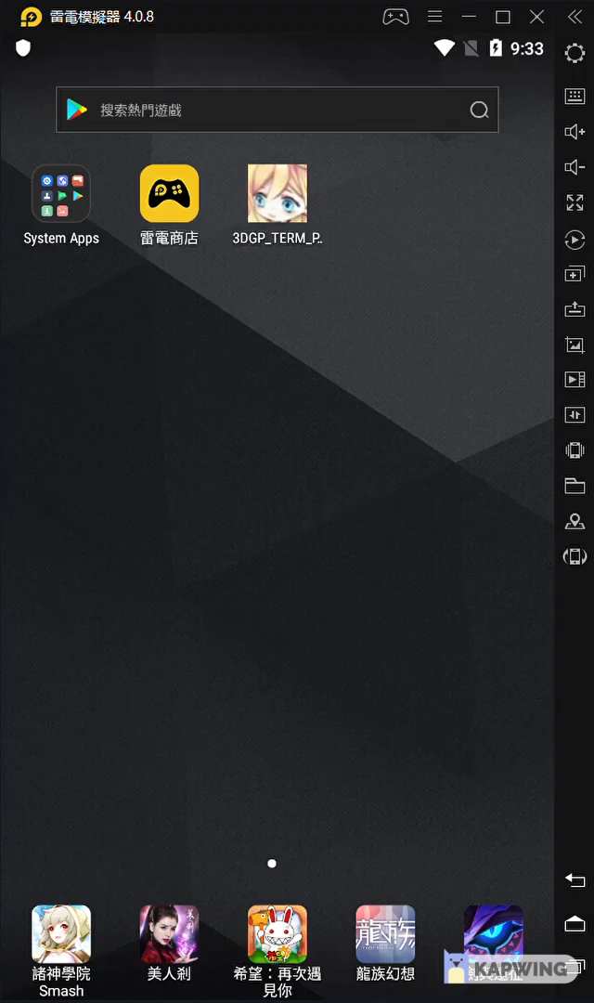
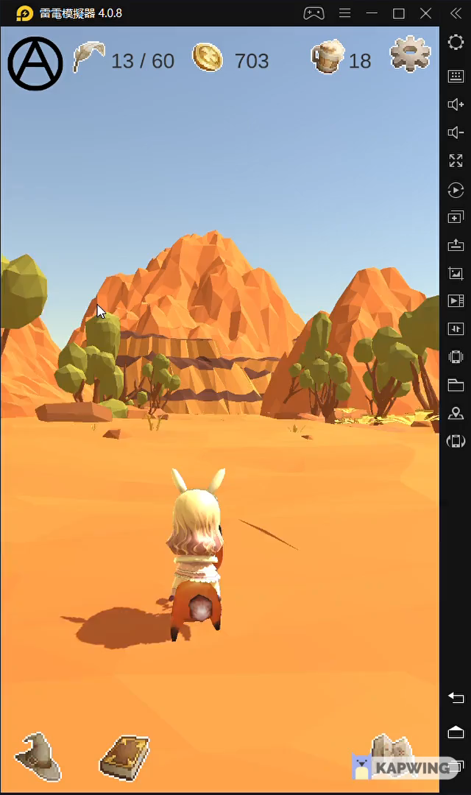
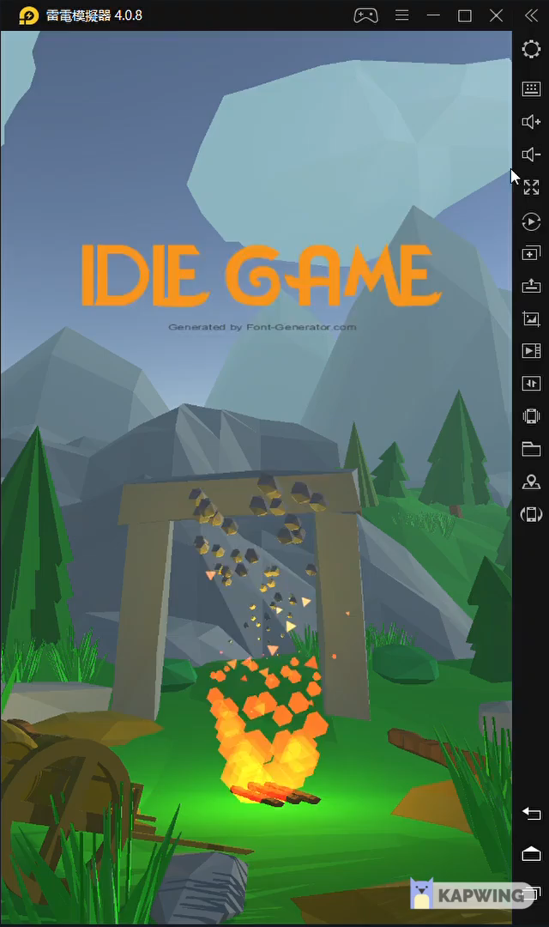
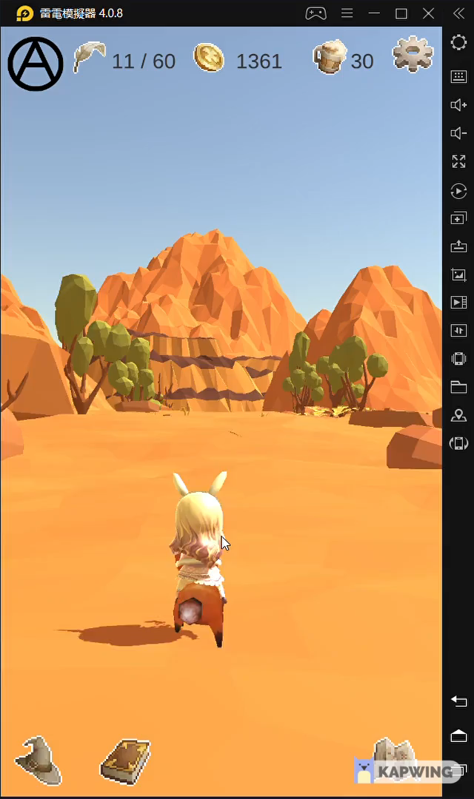
Play a demo movie (~1 minute)

Slide 4
Content
Game Design
System Architecture
Techniques
Implementation items
Member Contribution List
Task List with milestones
Demo
Conclusion

Slide 5
Game Design
Game Features
Game Story
Game Goal
Game Control
Levels
Particle systems
Sound effects

Slide 6
Game Design - Game features
Auto-fighting : All of the fighting is automatic. Player can only adjust the skills and equipment and decide whether to challenge boss.
Idle : Because of auto-fighting, player can put down cellphone and the character will be more powerful automatically. If player can’t defeat the boss, player should wait more time until the character is strong enough.

Slide 7

Game Design - Game story
Loli-Chan accidentally travel in a fantasy world. There are many monsters never seen on Earth. To find out the way home, he started to wander and met some friends. They told Loli-Chan that the way home is in the den of the dragon boss. Therefore Loli-Chan has to defeat the dragon boss. To improve his fighting skills and get more powerful equipment, Loli-Chan embarks on a difficult journey and keeps fighting day and night……

Slide 8
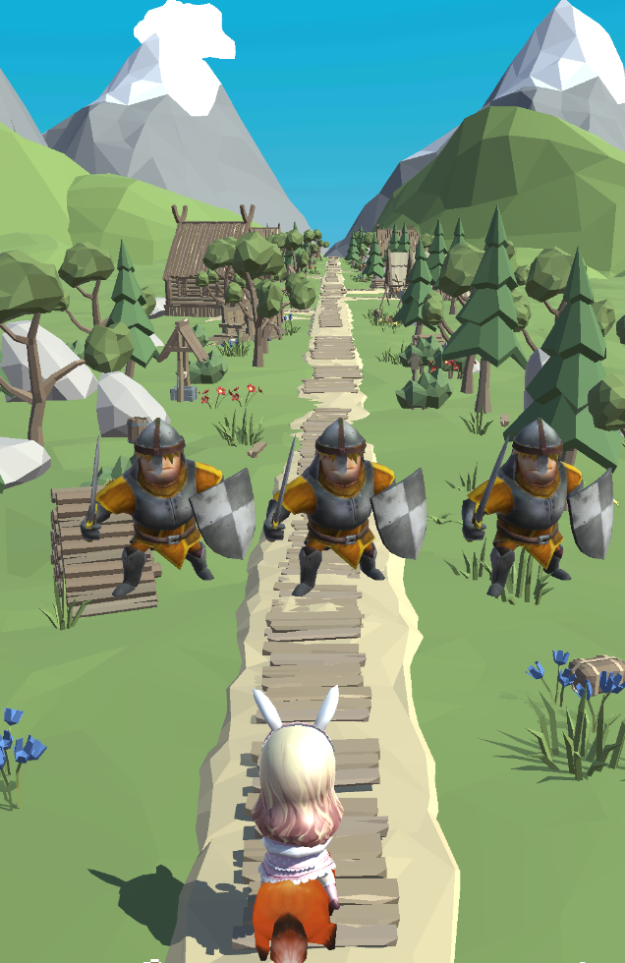
Game Design - Game goal
Goal : Help Loli-Chan to find out the way home
Method :
In this journey, there seem to have endless monsters.
Become stronger and try to challenge boss. After defeating monsters, Loli-Chan can get some rewards including experience, coins, equipment and new skills. These will make Loli-Chan more stronger and more easier to defeat final boss.

Slide 9
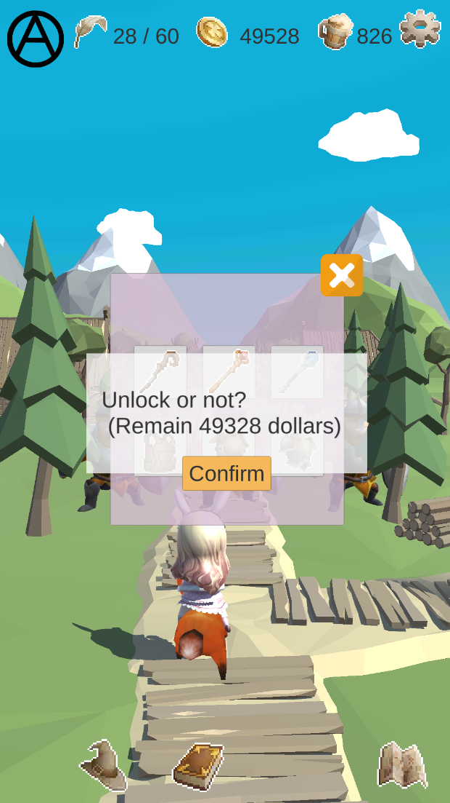
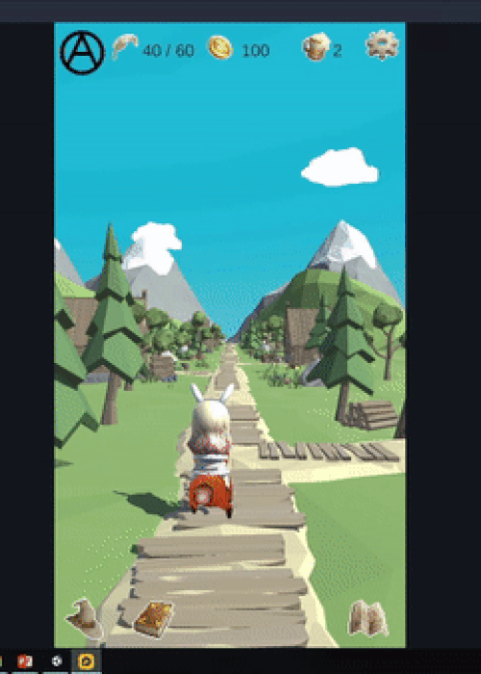
Game Design - Game control
Click:
Challenge boss
Buy equipment
Change skill
Exit game
Drag:
1. Swap skill order

Slide 10
Game Design – Game level(s)
Level1: village
Normal stage (10~20 second pass)
Boss stage(20~30 second)
Level2 : desert (Stronger monster and skill)
Normal stage(10~20 second pass)
Boss stage(40~60 second pass)

Slide 11

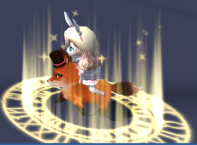
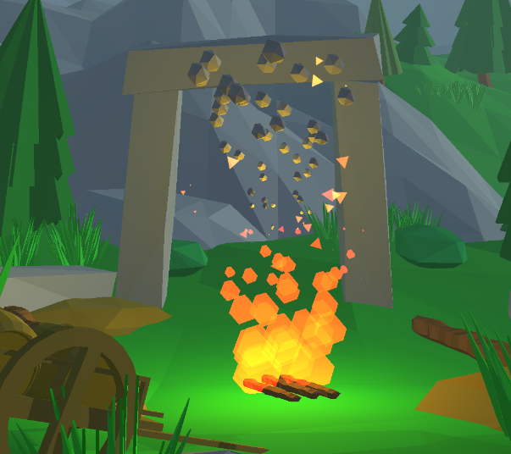
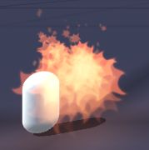


Game Design – Particle systems
Skills:
10 skills, each of them has its own particle effect
Environment:
Fire and smoke in the start menu.

Slide 12
Game Design – Sound effects
Walking
Get coin
Victory
Lose
Skill
Attack
Background(2)

Slide 13
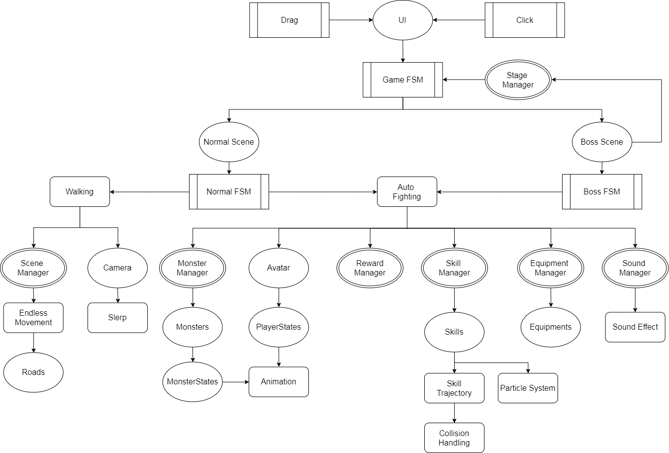
System architecture

Slide 14
Technical section
Must implement three techniques
These techniques must be implemented on your own
Show us the source code
Show all techniques

Slide 15
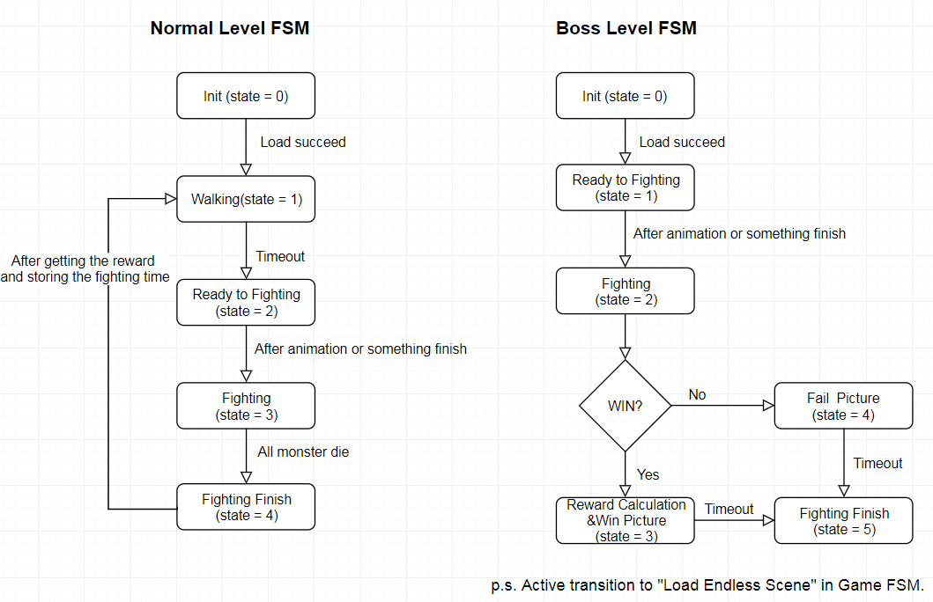
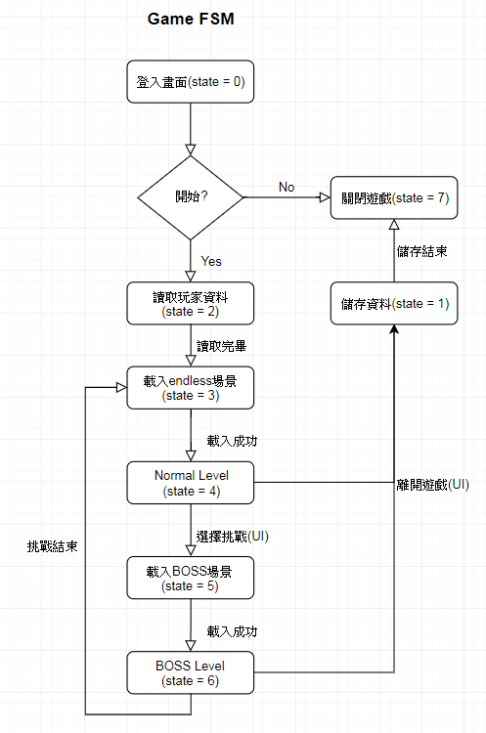
Finite state machine(s) in the game (1/3)

Slide 16
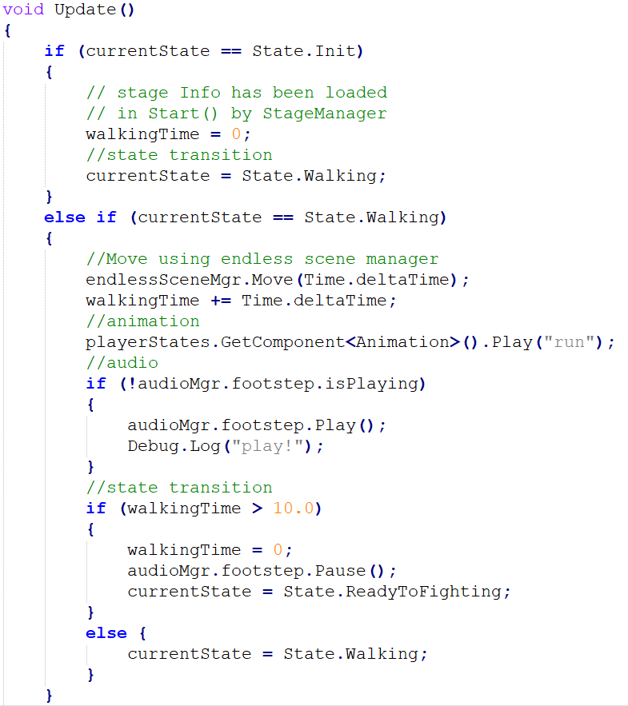
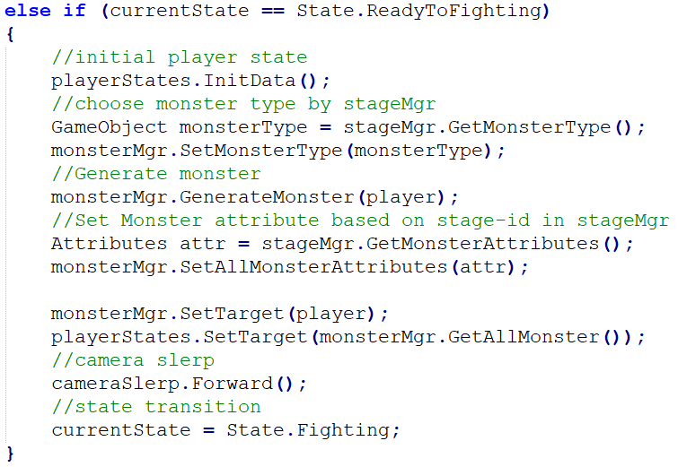
Finite state machine(s) in the game (2/3)

Slide 17
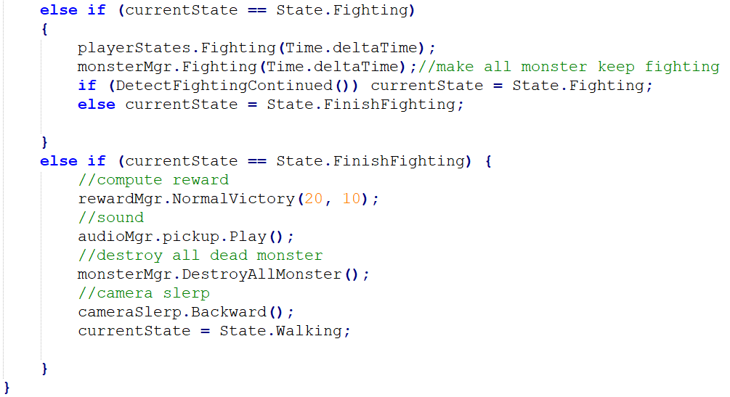
Finite state machine(s) in the game (3/3)

Slide 18
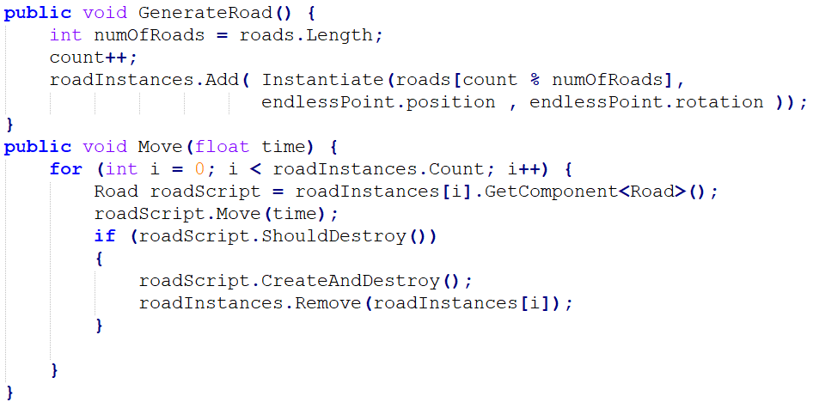
Endless Scene
Let the road looks like infinite

Slide 19
Save and Load (1/3)
Scriptable Object:
- It is easy to store the modified information.
- Reuse when different scene.
- A nice method to manage some resources.
- Used in skills, attributes and reward.
But scriptable object will reset after player quit the game
Save scriptable object as json file

Slide 20
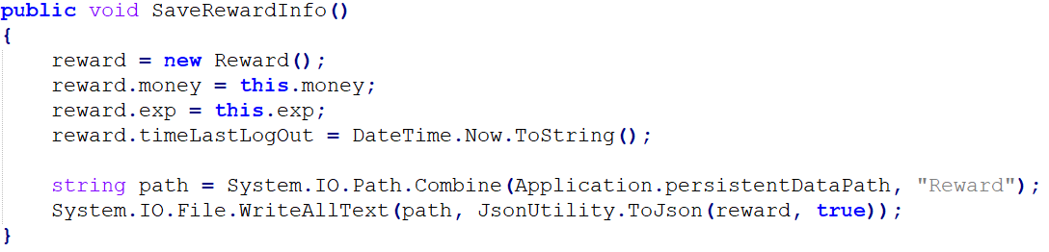
Save and Load (2/3)
Show Code:

Slide 21
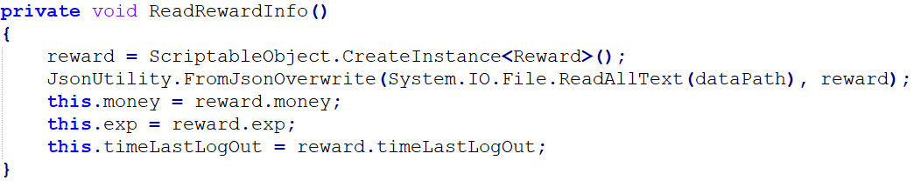
Save and Load (3/3)
Show Code:

Slide 22
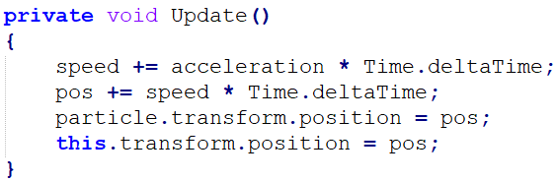
Skill Journey
Really simulate the trace skill casted

Slide 23
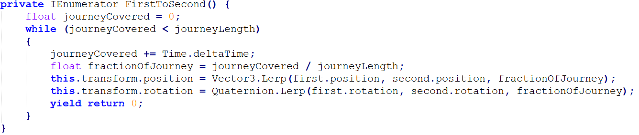
Camera Slerp
When starting to fight, gradually adjust main camera’s position and rotation

Slide 24
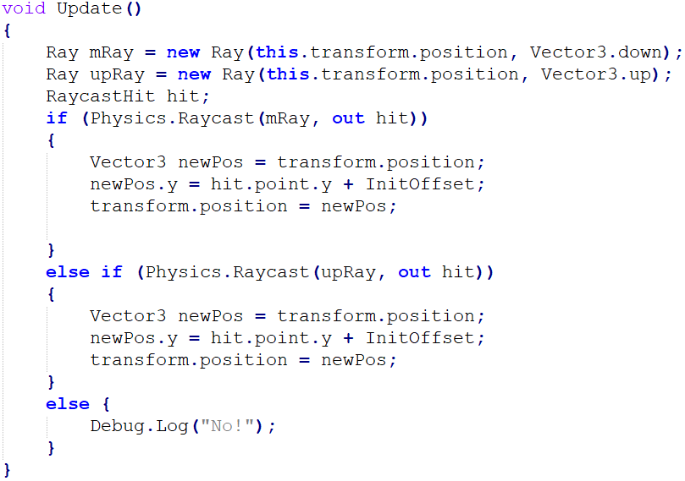
Physics (1/2)
1.Clamp on terrain
Let Loli-Chan and monsters clamp on terrain

Slide 25
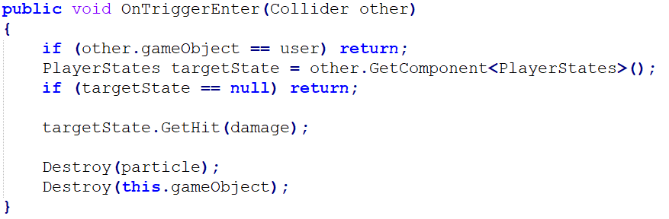
Physics (2/2)
2.Skill Collision
Compute damage after skill really touch the target.

Slide 26
Contributions & Implementation items
 | Tasks | Work hour | Contribution ratios
郭聖弘 | Battle scene, particle effect, sound effect, finite state machines, skills , player attribute | About 55 hours | 55%
洪冠群 | UI panel, Equipment, skill order, reward computing, Save and Load | About 40 hours | 45%

Slide 27
Milestones & Schedule
 | 郭聖弘 | 洪冠群
M1(~2019/11/22) | Create game‘s environment | Find models with proper animation
M2(2019/11/23~2019/12/15) | Particle effect, skills, animation | Design all of UI and it’s function
M3(2019/12/15~2020/01/07) | Auto-fighting system, Finite state machine of normal and boss | Save and load basic information (time, money ......)
M4(2020/01/07~2020/01/12) | Boss stage design, more skills, BGM, sound effect | Reward computing, equipment, skill order and also record them
M5(2020/01/10~) | Test and debug | Test and debug

Slide 28
Online Demo
Run your program
Run through your game

Slide 29
Conclusion
Idle game by Unity(Platform : android)
3 finite state machines
Skill, equipment and reward
Particle effect and sound effect.

